Slide 1


Introducing Fiddler
Web Debugging for
Performance and Operations
www.fiddler2.com/perf/

Slide 2

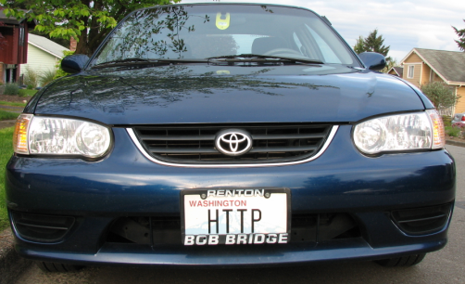
About Eric
Program Manager - Internet Explorer
      IE7: Networking; IE8: Security
Developer of TamperIE, IEToys, Fiddler, Meddler, etc…

Slide 3
What is Fiddler?
Freeware Web Debugging Platform
Easily installed from www.fiddler2.com
Runs as a local proxy; registers as system proxy while capturing
View, analyze and modify web traffic from any application that supports a proxy; including most devices (e.g. Windows Mobile)
Enables HTTPS interception via self-signed certificate
Extremely extensible, via JavaScript or .NET assemblies

Slide 4
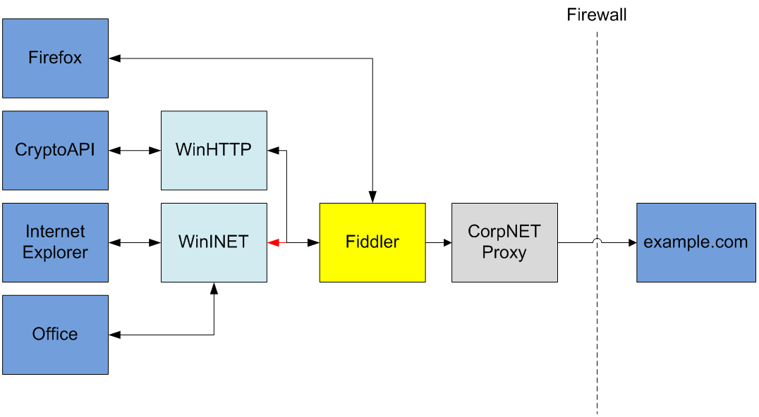
Intercepting Web Traffic

Slide 5

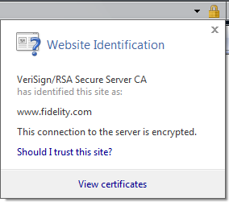
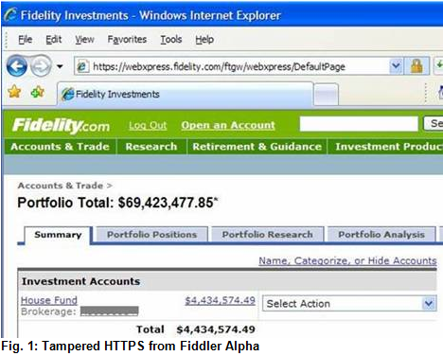
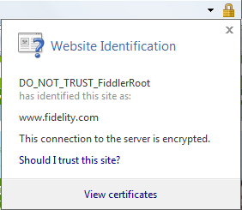
HTTPS support
Man-in-the-middle – Intercepts HTTPS CONNECT tunnels and shows raw traffic

Slide 6
Fiddler for Performance
Measure / analyze / simulate the end-user experience.
  Measure request size, page weight
  Analyze caching, compression, page composition
  Simulate low-speed / high-latency connections

Slide 7
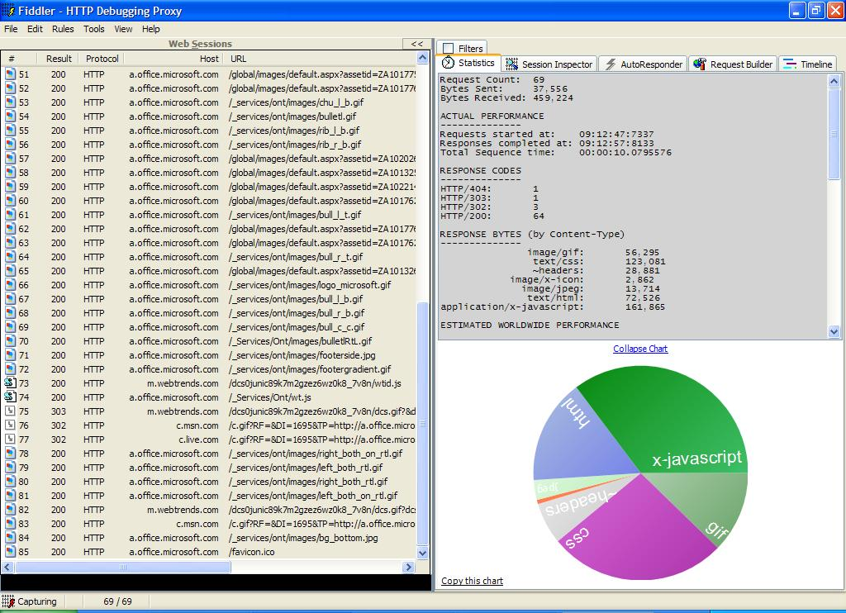
Performance Statistics

Slide 8
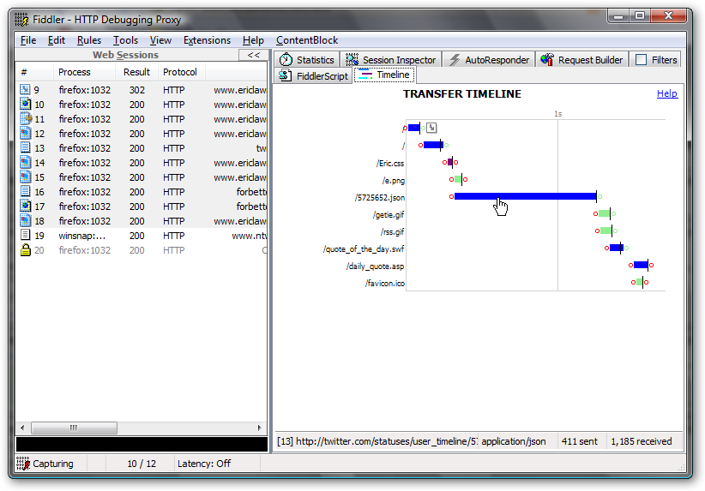
Session Timeline
Notes:
The “Timeline” tab reveals the timing of request and responses. Right-click the timeline to enable Fiddler’s “Streaming” mode.
In the session list, hit the “P” key to select the parent of the current request; hit the “C” key to select the current request and all of its children (sub-downloads).

Slide 9
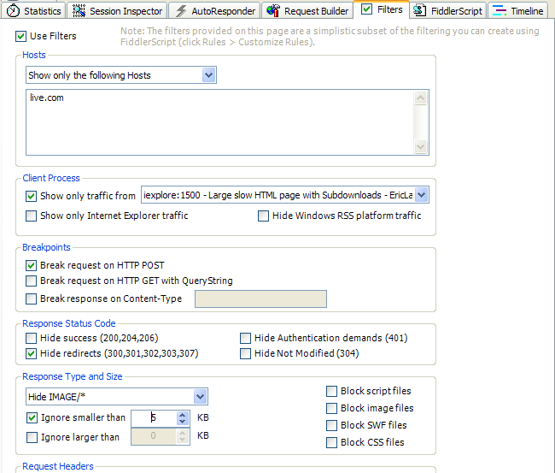
Filters
Notes:
The “Filters” tab enables you to easily configure Fiddler to show only content of interest. Custom Rules written in JavaScript are more powerful, but the Filters tab is often all you’ll need.

Slide 10
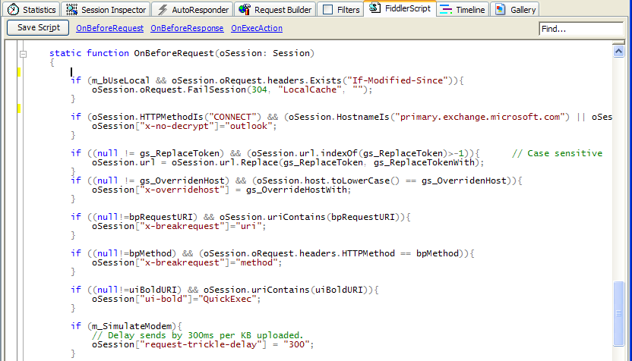
Custom Rules
Notes:
Custom Rules written in JavaScript enable very powerful traffic filtering and modification. You can extend the Fiddler user-interface using rules. See http://www.fiddler2.com/fiddler/dev/ for more information.

Slide 11
Traffic Modification
  Redirect requests to a particular datacenter
  Simulate a downed server
  Prototype the performance cost of site changes
  Etc…

Slide 12
Traffic Archives
Preserves the traffic and timings in compressed .SAZ (Session Archive ZIP) format
Great for regressing bugs
Remote user capture using FiddlerCap
Notes:
Tip: .SAZ files are maintained as ZIP archives. If you rename a .SAZ file to .ZIP, you can open it with Windows Explorer or WinZip and explore the traffic and timings stored within.

Slide 13
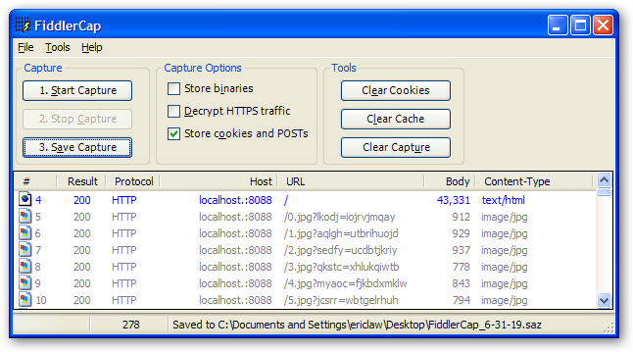
FiddlerCap - www.fiddlercap.com
Notes:
FiddlerCap is a lightweight, easy-to-use client that archives traffic in .SAZ format. It’s used by the Windows Live product support team and the IE Beta team for repro capture from non-technical users. SAZ files can be submitted by email or bug reporting systems for analysis by the product team.
Several simple configuration options are available. By default, the tool minimizes capture size by dropping binary response bodies (e.g. images/video) but retaining their headers for analysis.

Slide 14
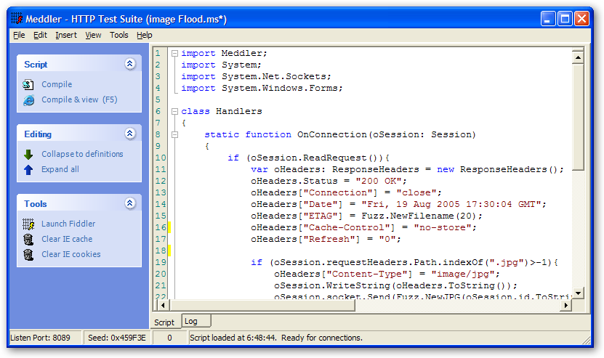
Meddler - www.fiddler2.com/meddler/
Notes:
Meddler is a complementary tool to Fiddler. It is a simple scriptable HTTP server that allows full control over response headers, content, and connection handling. It can be useful for testing client code or performing offline demos.

Slide 15
Learn More…
www.fiddler2.com/fiddler/help/ for tutorials, demonstration videos, references, RSS, and the Fiddler Discussion Group
www.fiddler2.com/perf/ for performance-related content
ericlaw@microsoft.com

